Slide 1
Prototype for Media Vault Project
Team 4
(Su Yatti Moe Zin - 8741107)

Slide 2
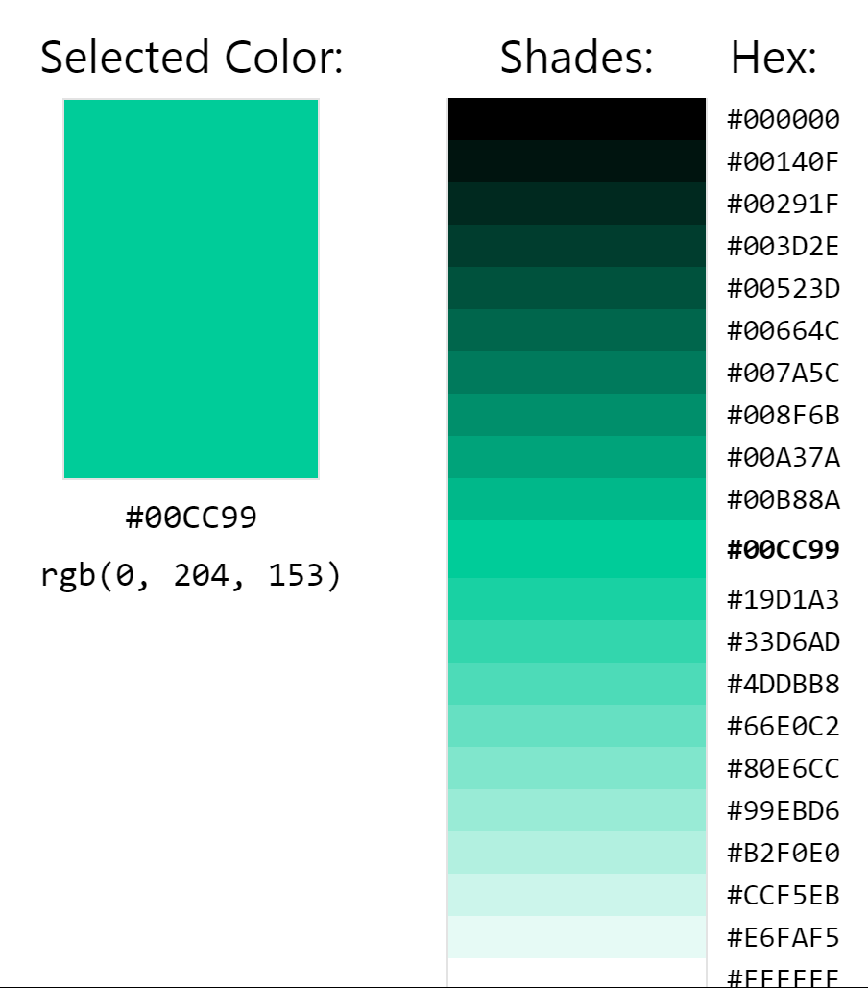
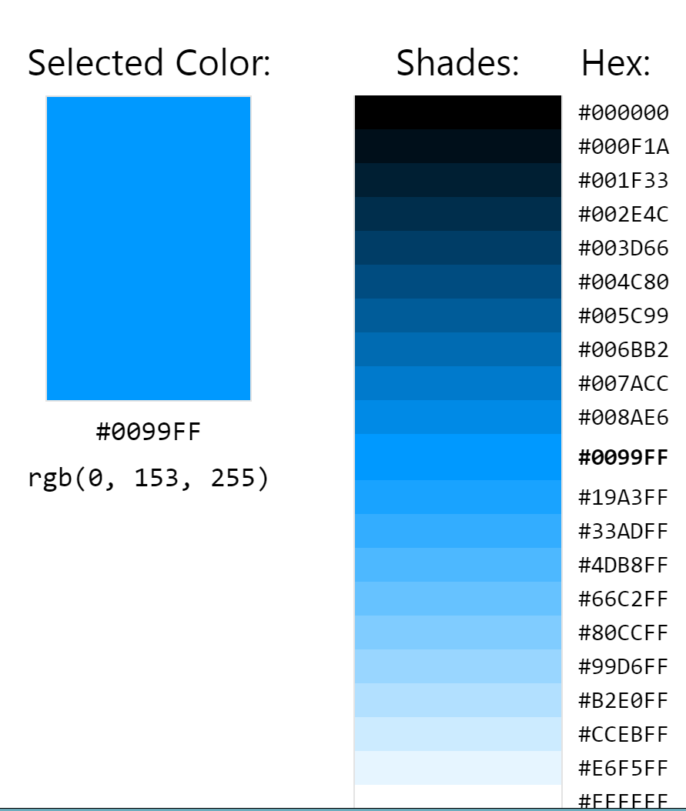
Theme & Colour scheme
Cool/ Calm
(18 votes)
Fresh/ Nature
(4 votes)

Slide 3
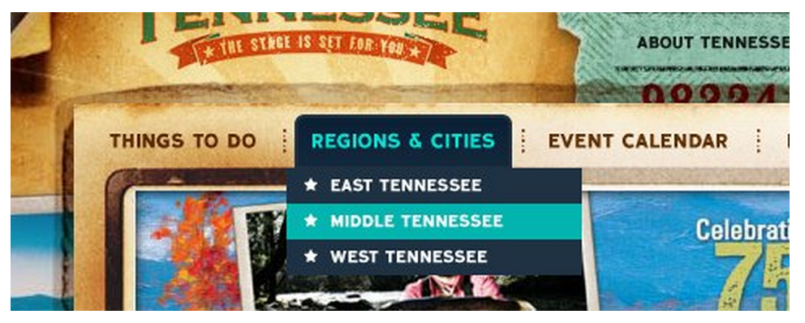
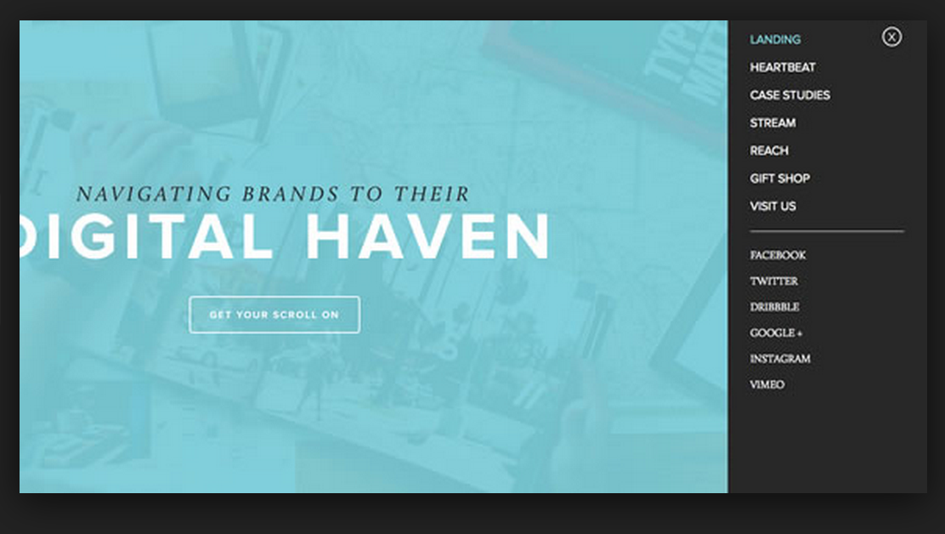
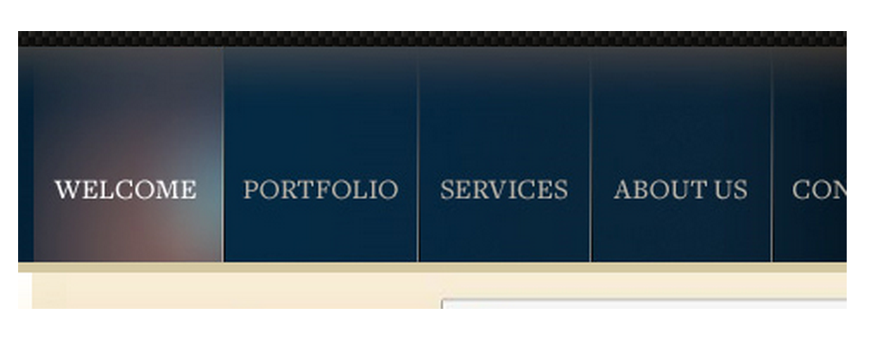
Menu Bar Designs
5 votes
15 votes
2 votes

Slide 4




Colour Scheme & Font
#00000
#949494
#008161
#00CC99
#FFFFFF
Aharoni - Hello World!
Calibri (Body) - Hello World!
Arabic Typesetting - Hello World!

Slide 5
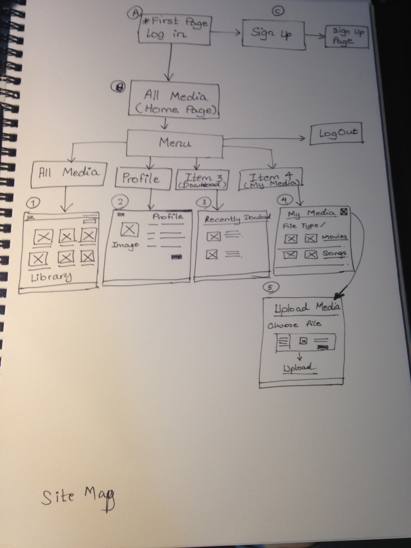
Site Map

Slide 6
Site Map Structure

Slide 7
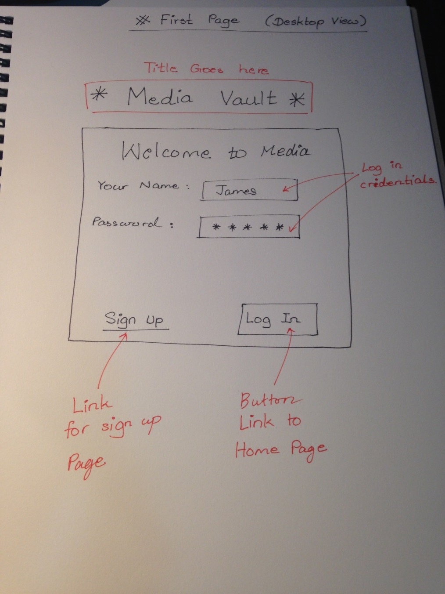
Log in Page Sketches

Slide 8
First page with Login and Sign up
Media Vault
Welcome User!
Your Name:
Password:
Log In
Sign up

Slide 9
Sign up page
Media Vault
Sign up
Your Name:
Password:
Confirm Password:
Media account:
Sign up

Slide 10
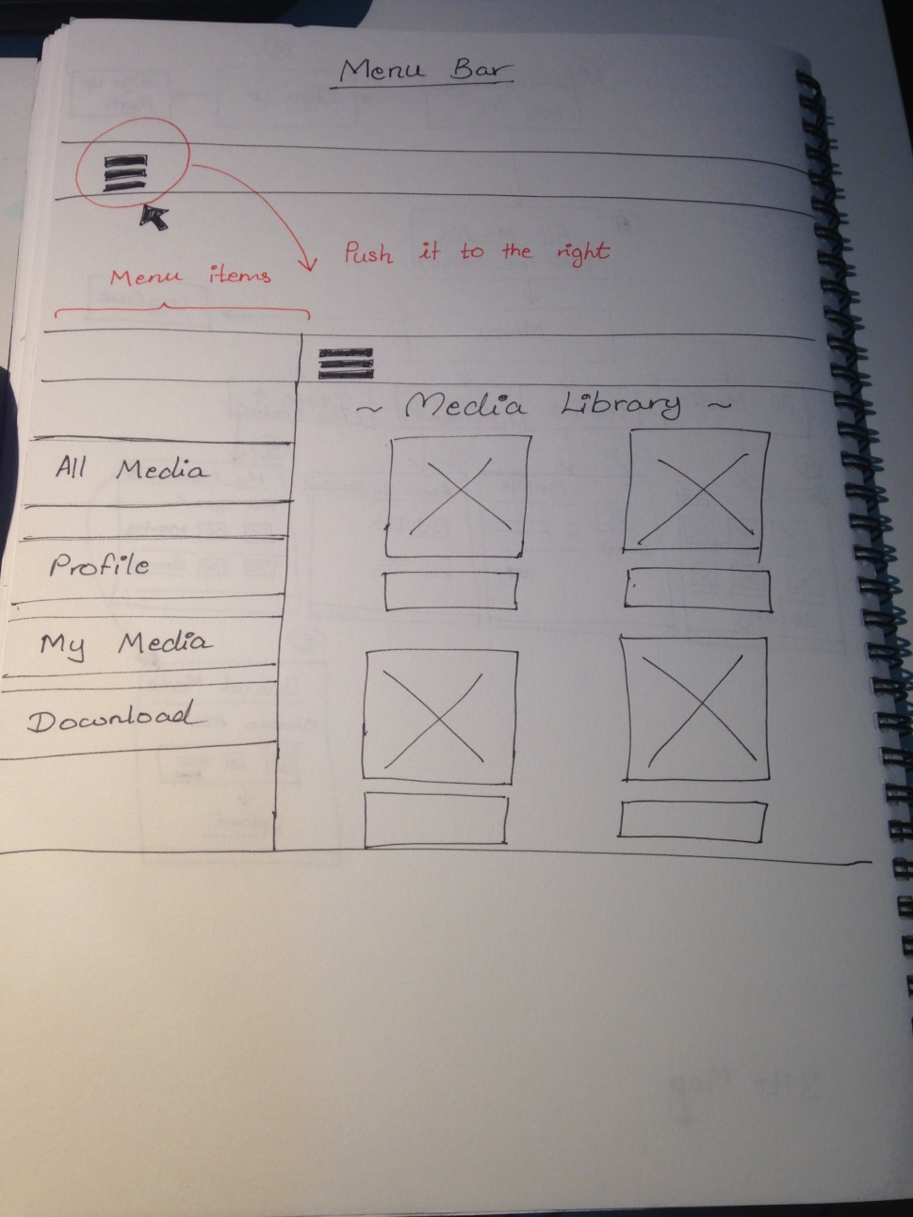
Menu Bar sketches

Slide 11
Menu Bar
Highlight when hover
Slide right when clicked
Menu
Log out
All Media
Image
Image
My Profile
My Media
Download
Text
Text

Slide 12
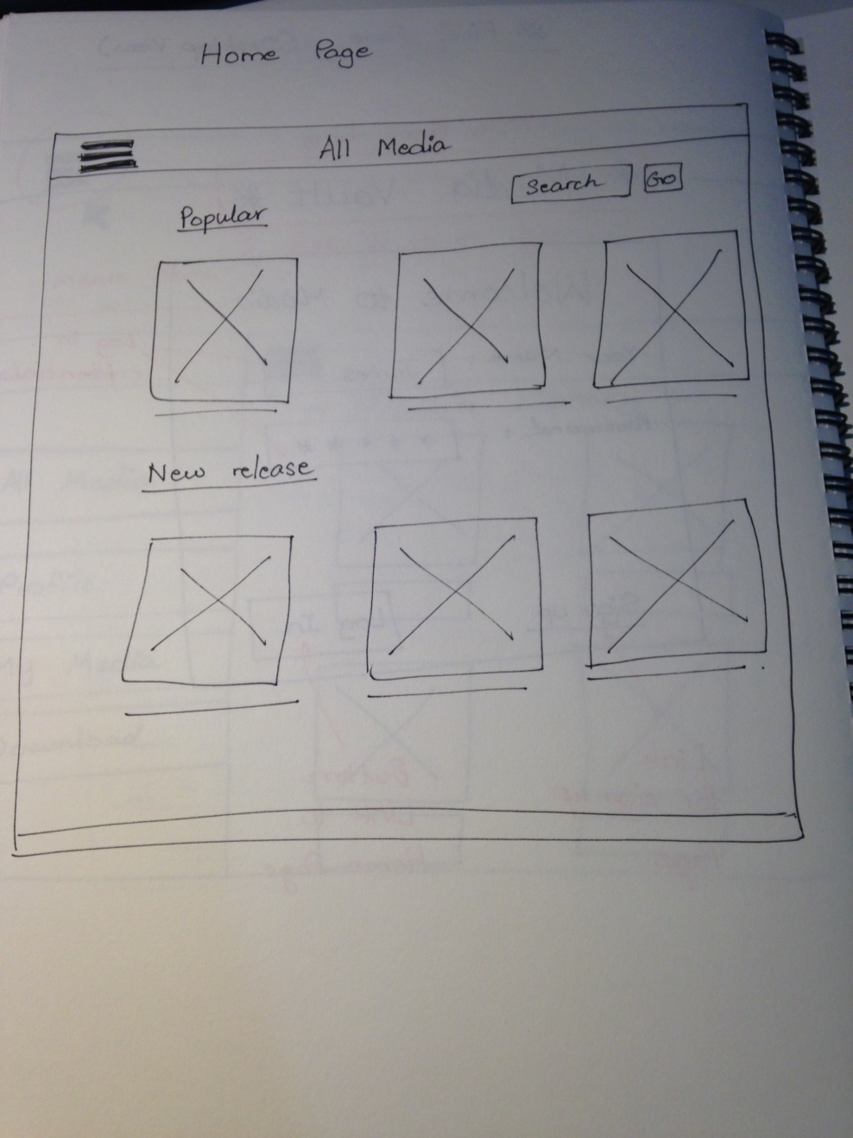
Home Page sketches

Slide 13
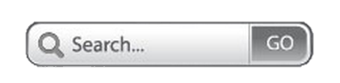
Home Page (Show the general media library)
Media Library
Log out
Popular
Image
Image
Image
Text
Text
Text
New releases
Image
Image
Image

Slide 14
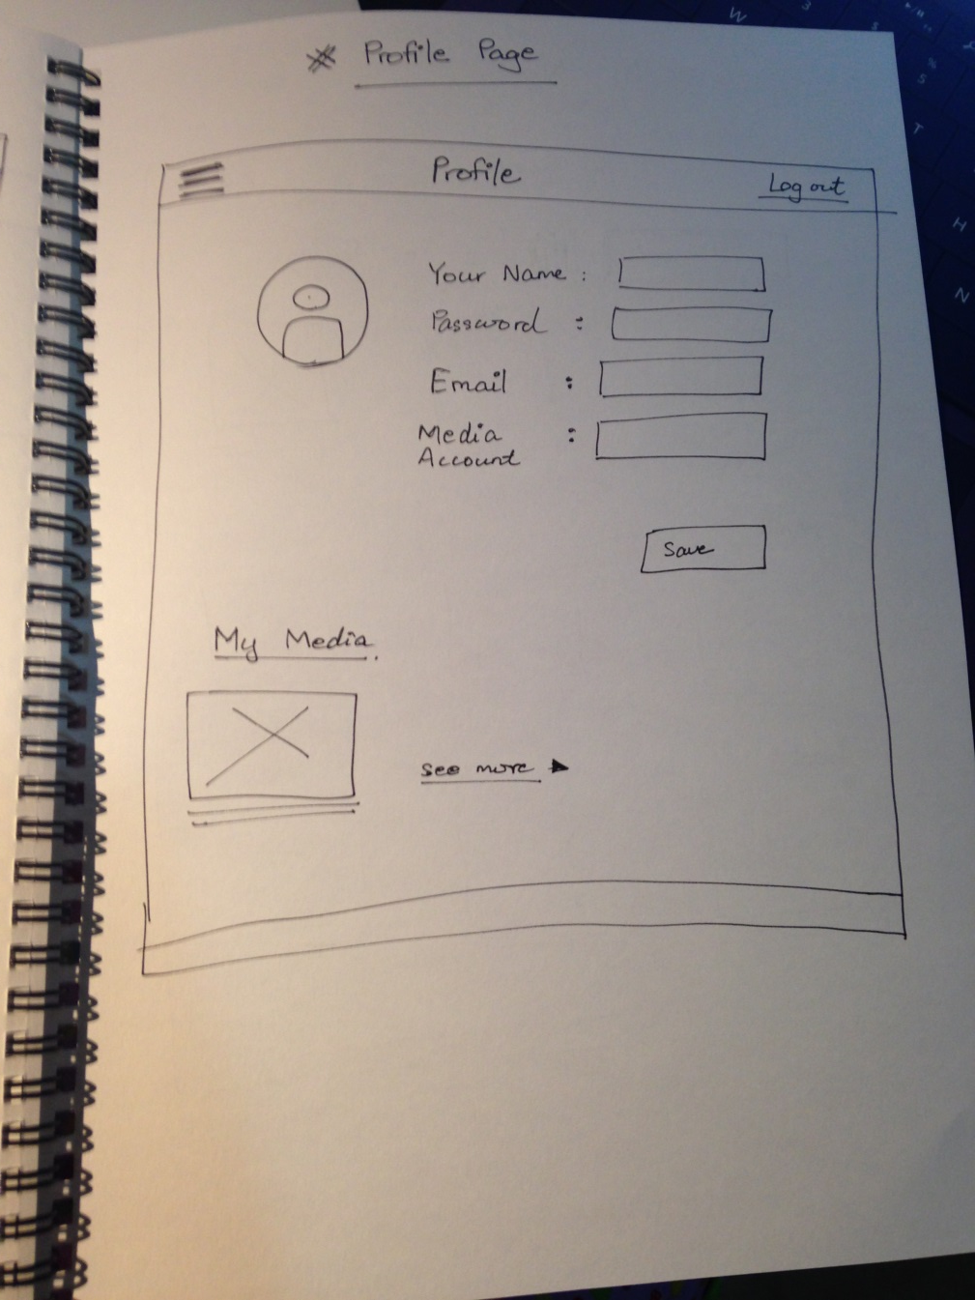
My Profile sketches

Slide 15
My Profile Page
Profile
Log out
Your Name:
Password:
Change picture
Email:
Media account:
Save changes

Slide 16
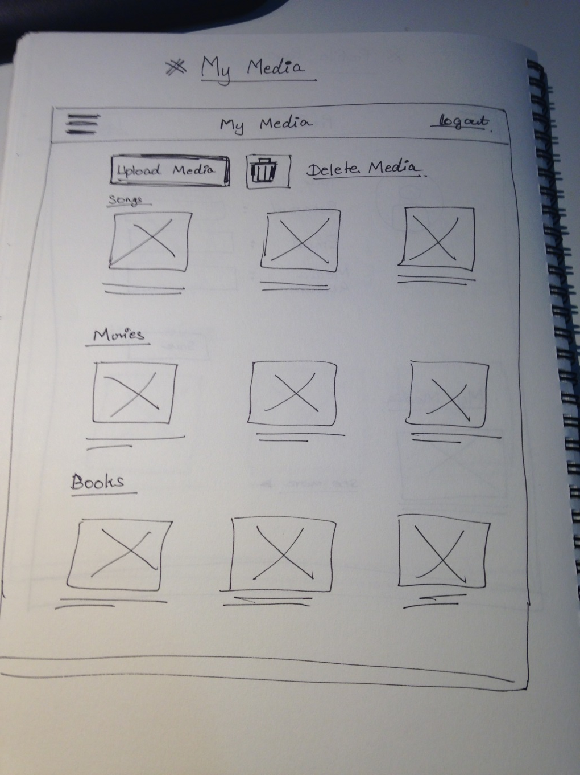
My Media Page sketches

Slide 17
My Media Page
My Media
Log out
Upload media
Image
Image
Image
Text
Text
Text
Image
Image
Image
Text
Text
Text

Slide 18
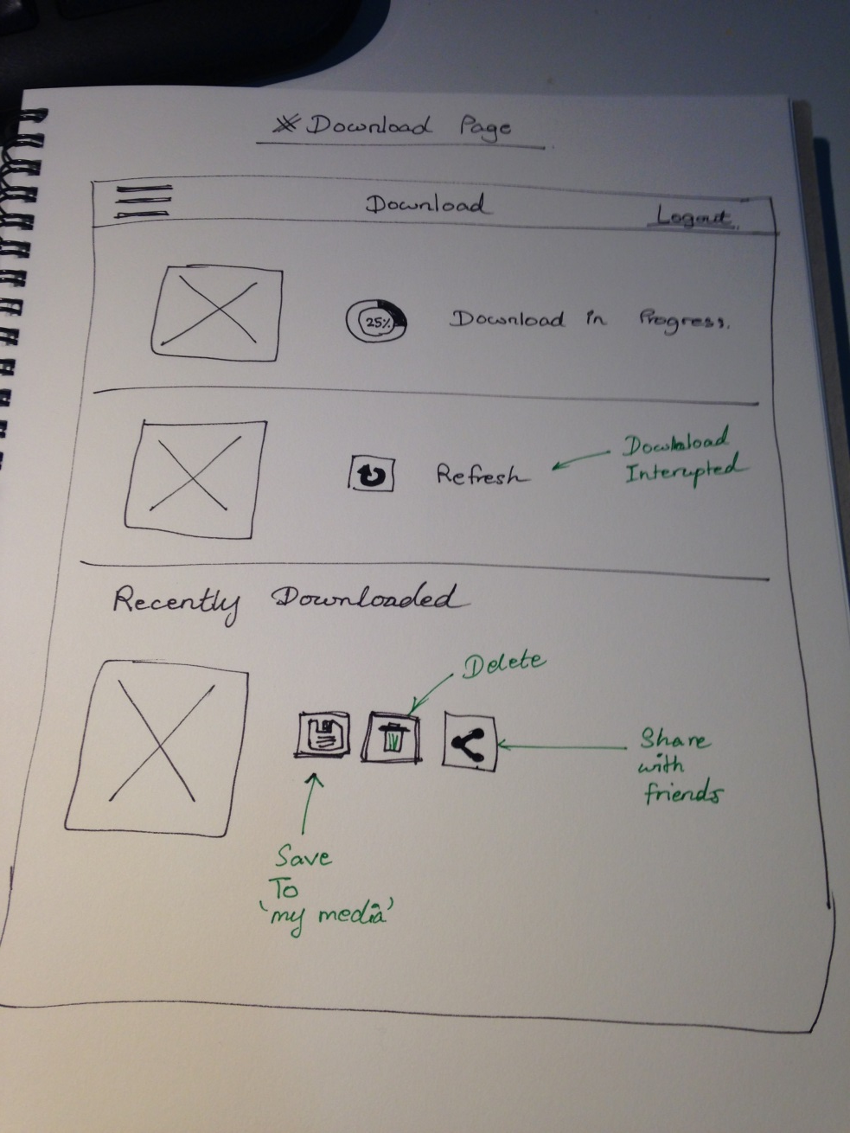
Download Page sketches

Slide 19
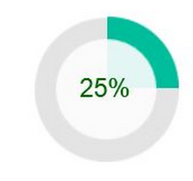




Download Page
Download
d
Log out
Image
Download in progress
Image
Refresh
Recently downloaded
Image

